Slide 1

Introduction to Python - Part 2
Python Operators

Slide 2
Python operators
Python Operators
Arithmetic Operators
Relational Operators
Logical Operators
Membership Operators
Bitwise Operators
Assignment Operators

Slide 3
Python operators
The most common arithmetic operators are:
+ (Addition)
- (Subtraction)
* (Multiplication)
/ (Division)
% (Modulus)
// (Floor Division)
** (exponentiation)

Slide 4
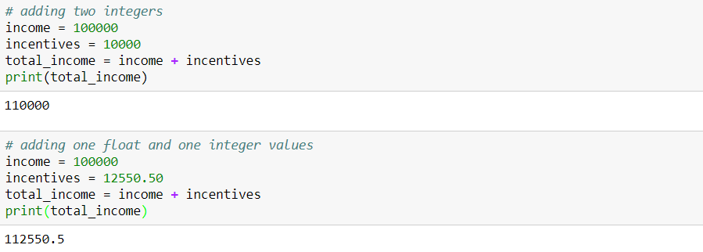
Arithmetic operators
Addition

Slide 5
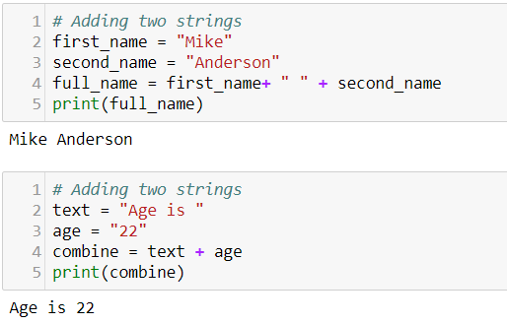
Arithmetic operators
Addition
Note that 22 is a string
Here two strings are getting concatenated

Slide 6
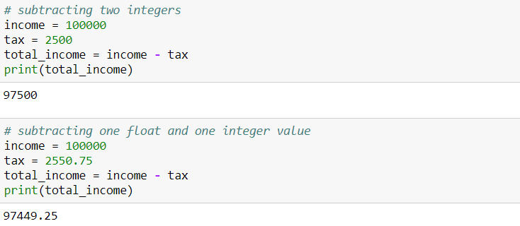
Arithmetic operators
Subtraction

Slide 7
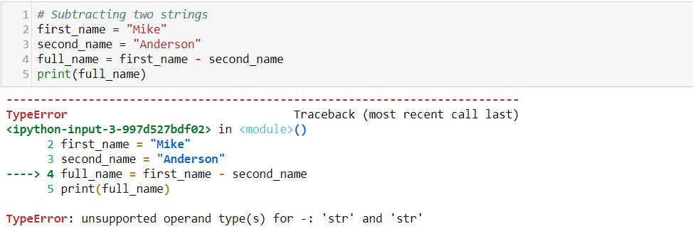
Arithmetic operators
Subtraction
When two strings are added, the + (addition) operator basically concatenates the two strings. Subtracting two strings does not make any sense.

Slide 8
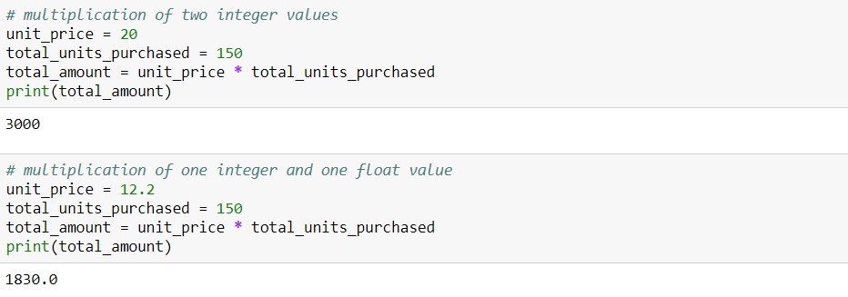
Arithmetic operators
Multiplication

Slide 9
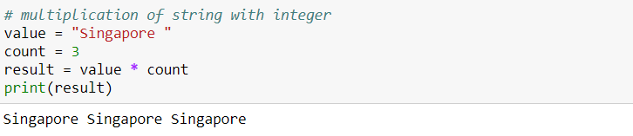
Arithmetic operators
Multiplication

Slide 10
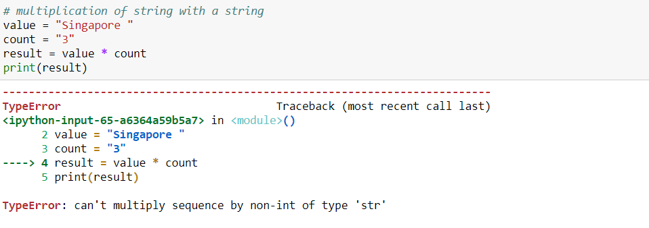
Arithmetic operators
Multiplication

Slide 11
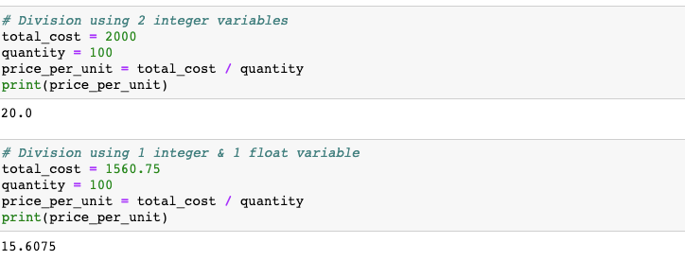
Arithmetic operators
Division

Slide 12
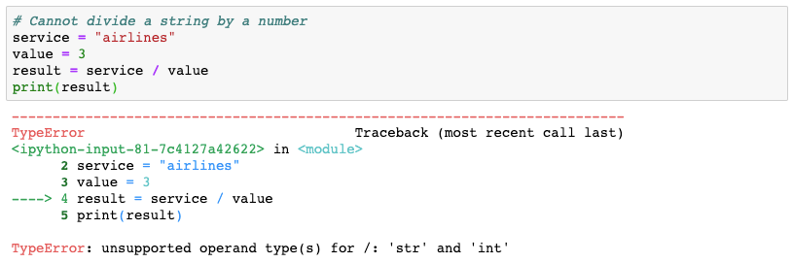
Arithmetic operators
Division

Slide 13
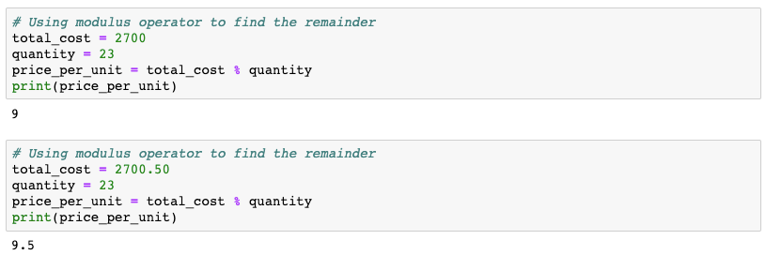
Arithmetic operators
Modulus

Slide 14
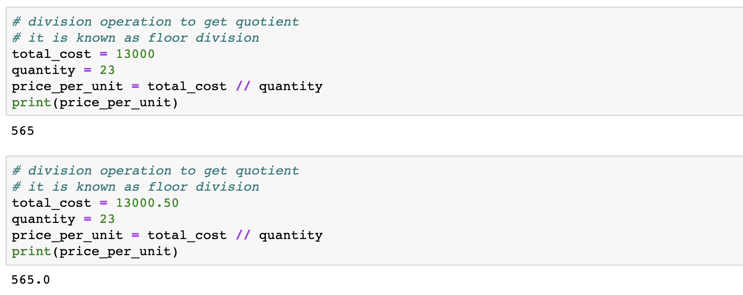
Arithmetic operators
Floor Division

Slide 15
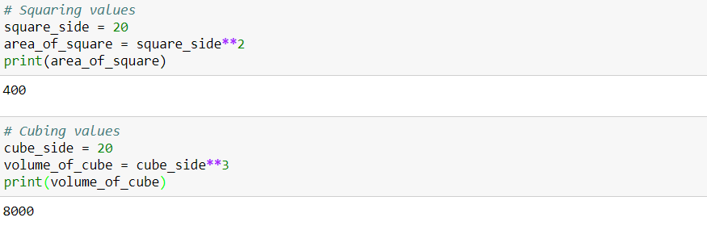
Arithmetic operators
Exponentiation

Slide 16
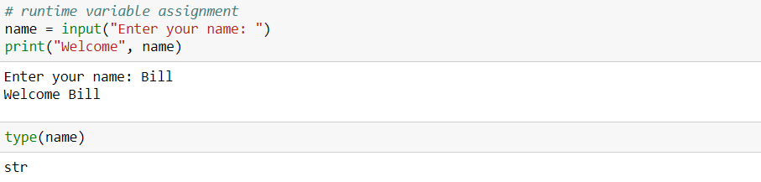
Runtime variable assignment

Slide 17
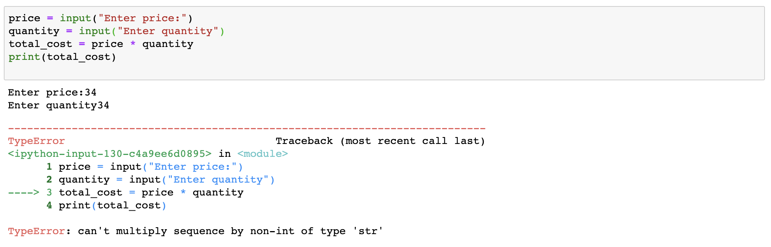
Runtime variable assignment

Slide 18
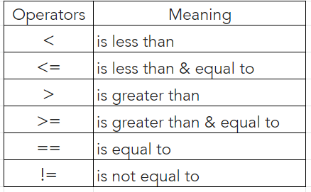
Relational operators
Relational operators are used to compare values and take certain decisions based on the outcome
Following are some of the relational operators:

Slide 19
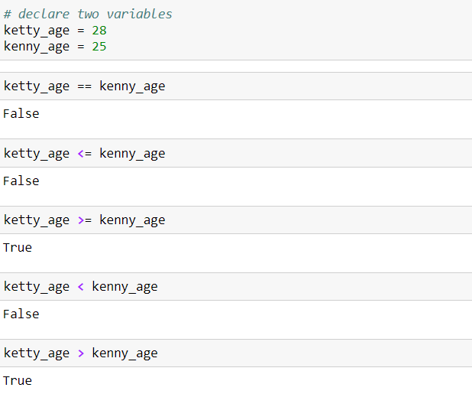
Relational operators

Slide 20
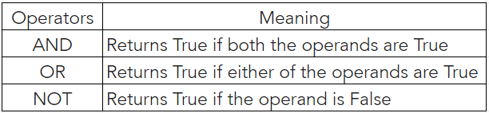
Logical operators
Logical operators in Python allow a program to make a decision based on multiple conditions
Each operand is considered a condition that can be evaluated to a true or false value

Slide 21
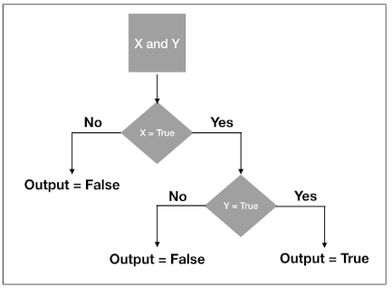
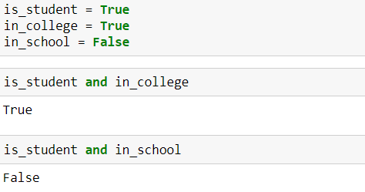
Logical operators
AND
If both the operands are true then it returns true

Slide 22
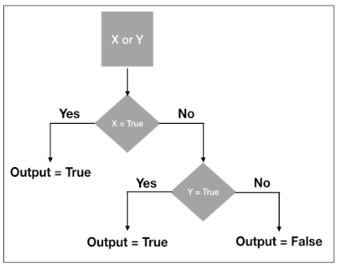
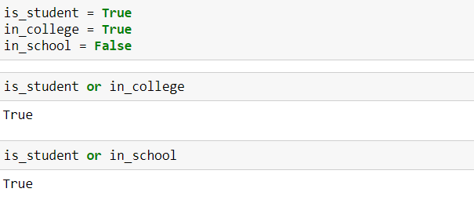
Logical operators
OR
If one of the operands are true then it returns true

Slide 23
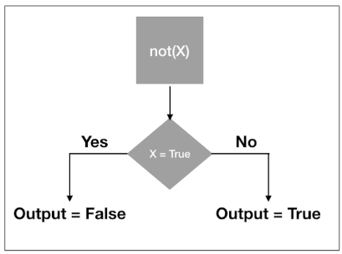
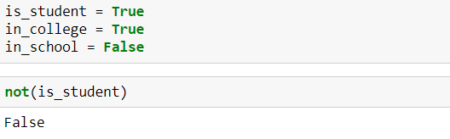
Logical operators
NOT
Reverses the result

Slide 24
Membership operators
Membership operators checks whether a value is a member of a sequence. The sequence may be a list, a string, a tuple, or a dictionary
in
The ‘in’ operator is used to check if a value exists in any sequence object or not
not in
A ‘not in’ works in an opposite way to an ‘in’ operator. A ‘not in’ evaluates to True if a value is not found in the specified sequence object. Else it returns a False.

Slide 25
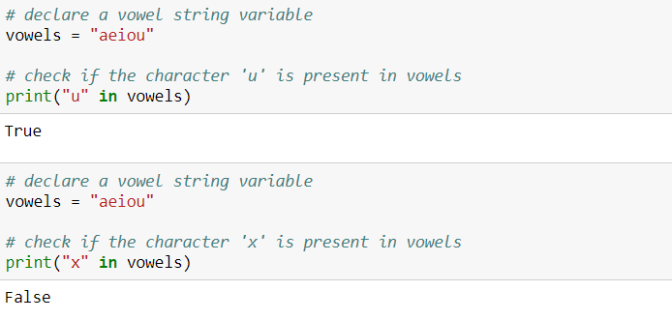
Membership operators
in

Slide 26
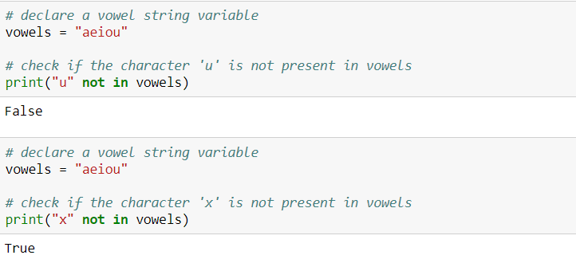
Membership operators
not in

Slide 27
Some bitwise operators
Python Bitwise Operators take one to two operands, and operates on it/them bit by bit, instead of whole
&
(Bitwise and)
|
(Bitwise or)
The binary and (&) takes two values and performs an AND-ing on each pair of bits.
Compared to &, this one returns 1 even if one of the two corresponding bits from the two operands is 1.

Slide 28
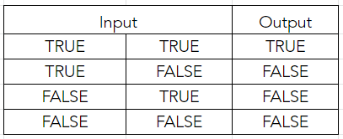
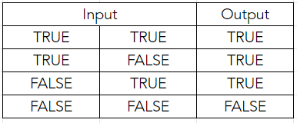
Truth tables
& (Bitwise and)
| (Bitwise or)

Slide 29
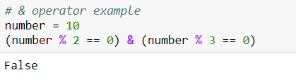
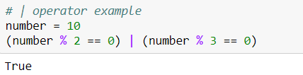
Some bitwise operators
Example:
& operator:
| operator:
(10 % 2 == 0) & (10 % 3 == 0)
Implies True & False. This results in Fasle
(10 % 2 == 0) | (10 % 3 == 0)
Implies True | False. This results in True

Slide 30
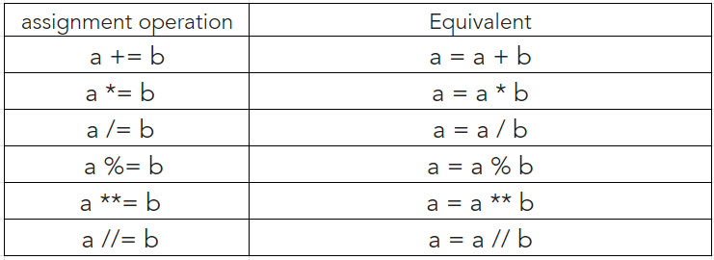
More assignment operators
The assignment operators are used to store data into a variable

Slide 31
THANK YOU
Presenter’s Name
Contact Us
support@knowledgehut.com
Presenter’s Designation

